Slide 1
IoT Unleashed Temperature Monitor
Presenter ::
Sudhanshu Gupta

Slide 2
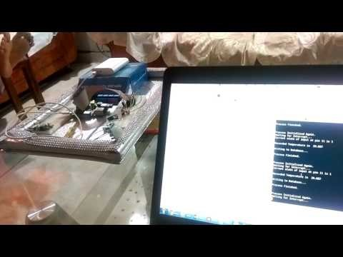
Demo
Video

Slide 3

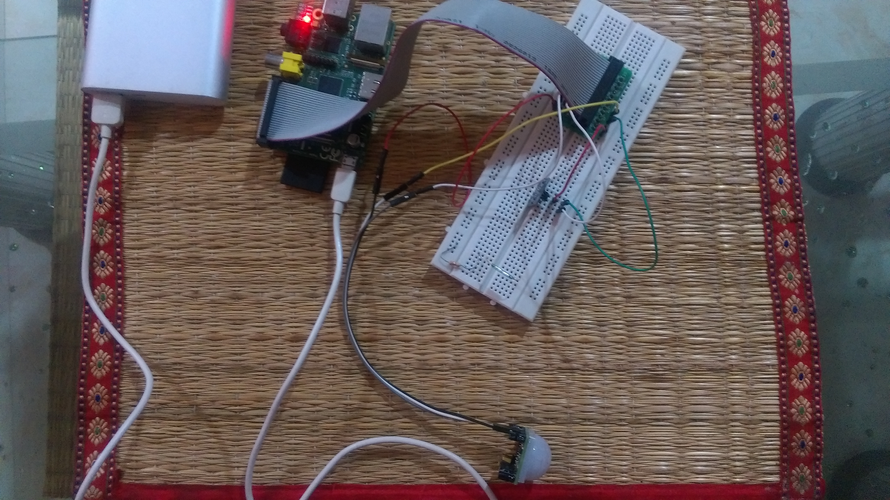
Physical Setup

Slide 4
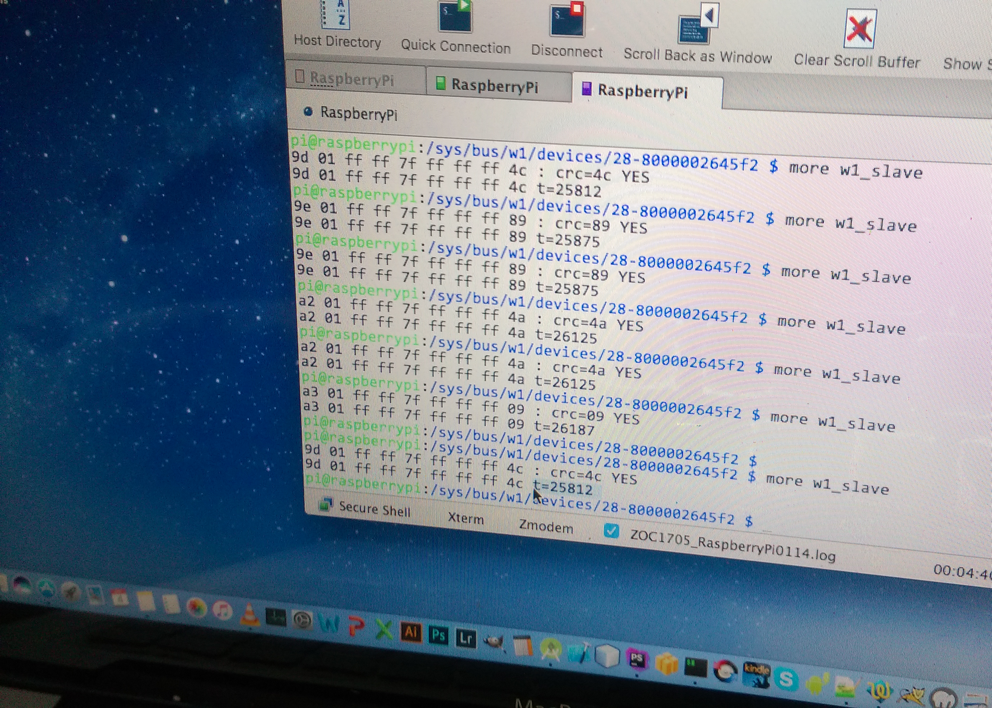

Slide 5


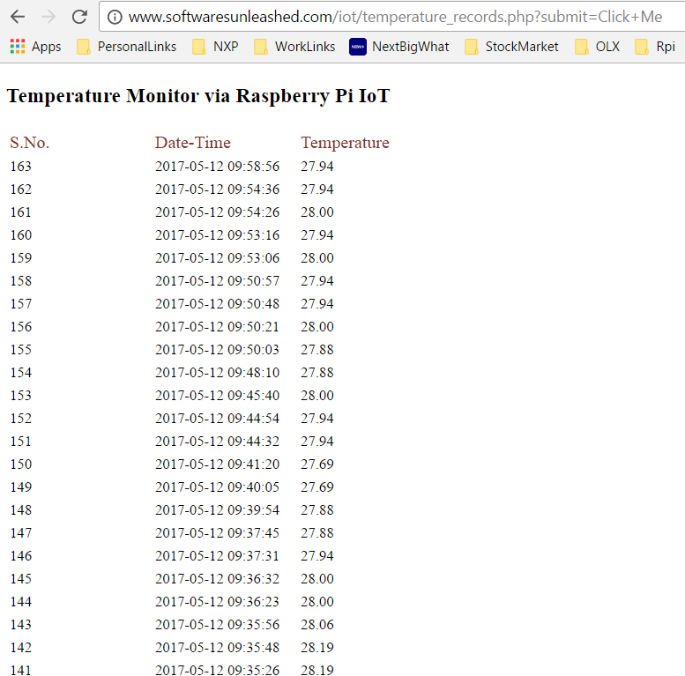
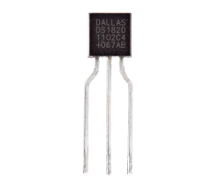
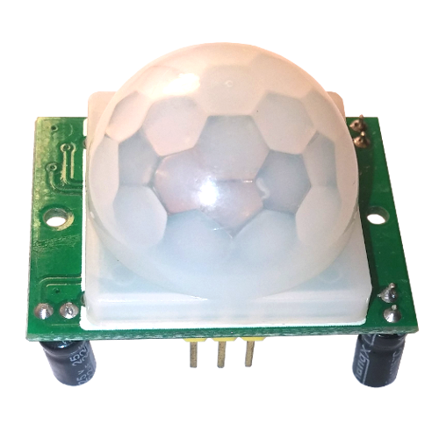
Arch Overview
Cloud Services
(Firebase / PHP)
Air Interface
WiFi
DevBoard
(Raspberry Pi)
DS1820
Temperature Sensor
GPIO
GPIO #4
3.3v
GND
5 v
PIR
Motion Sensor
GPIO #22 (Pin 11)

Slide 6



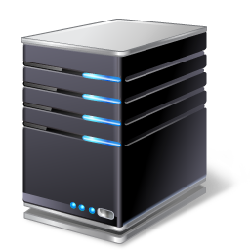
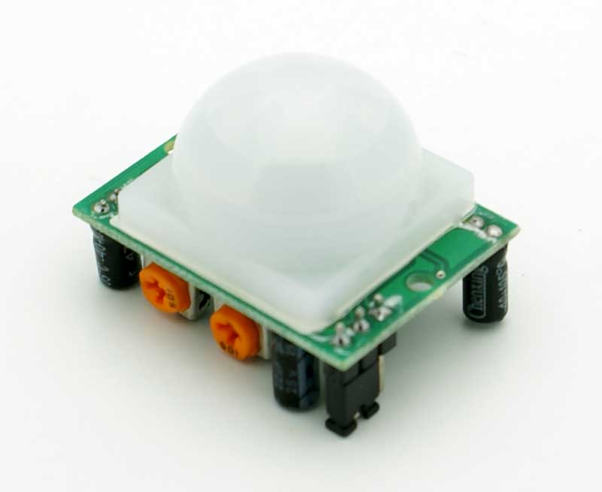

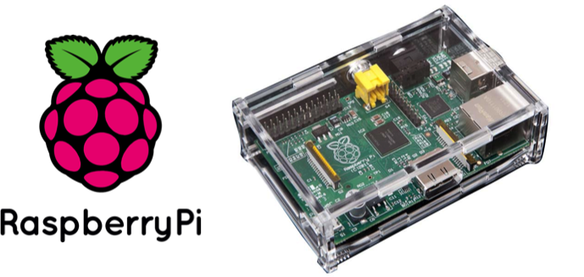

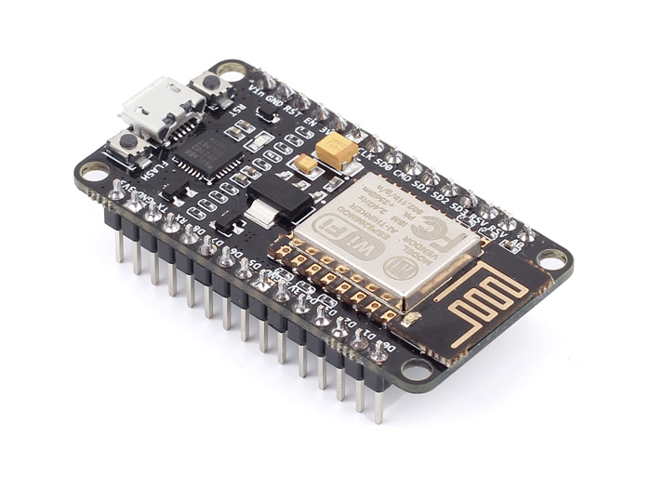
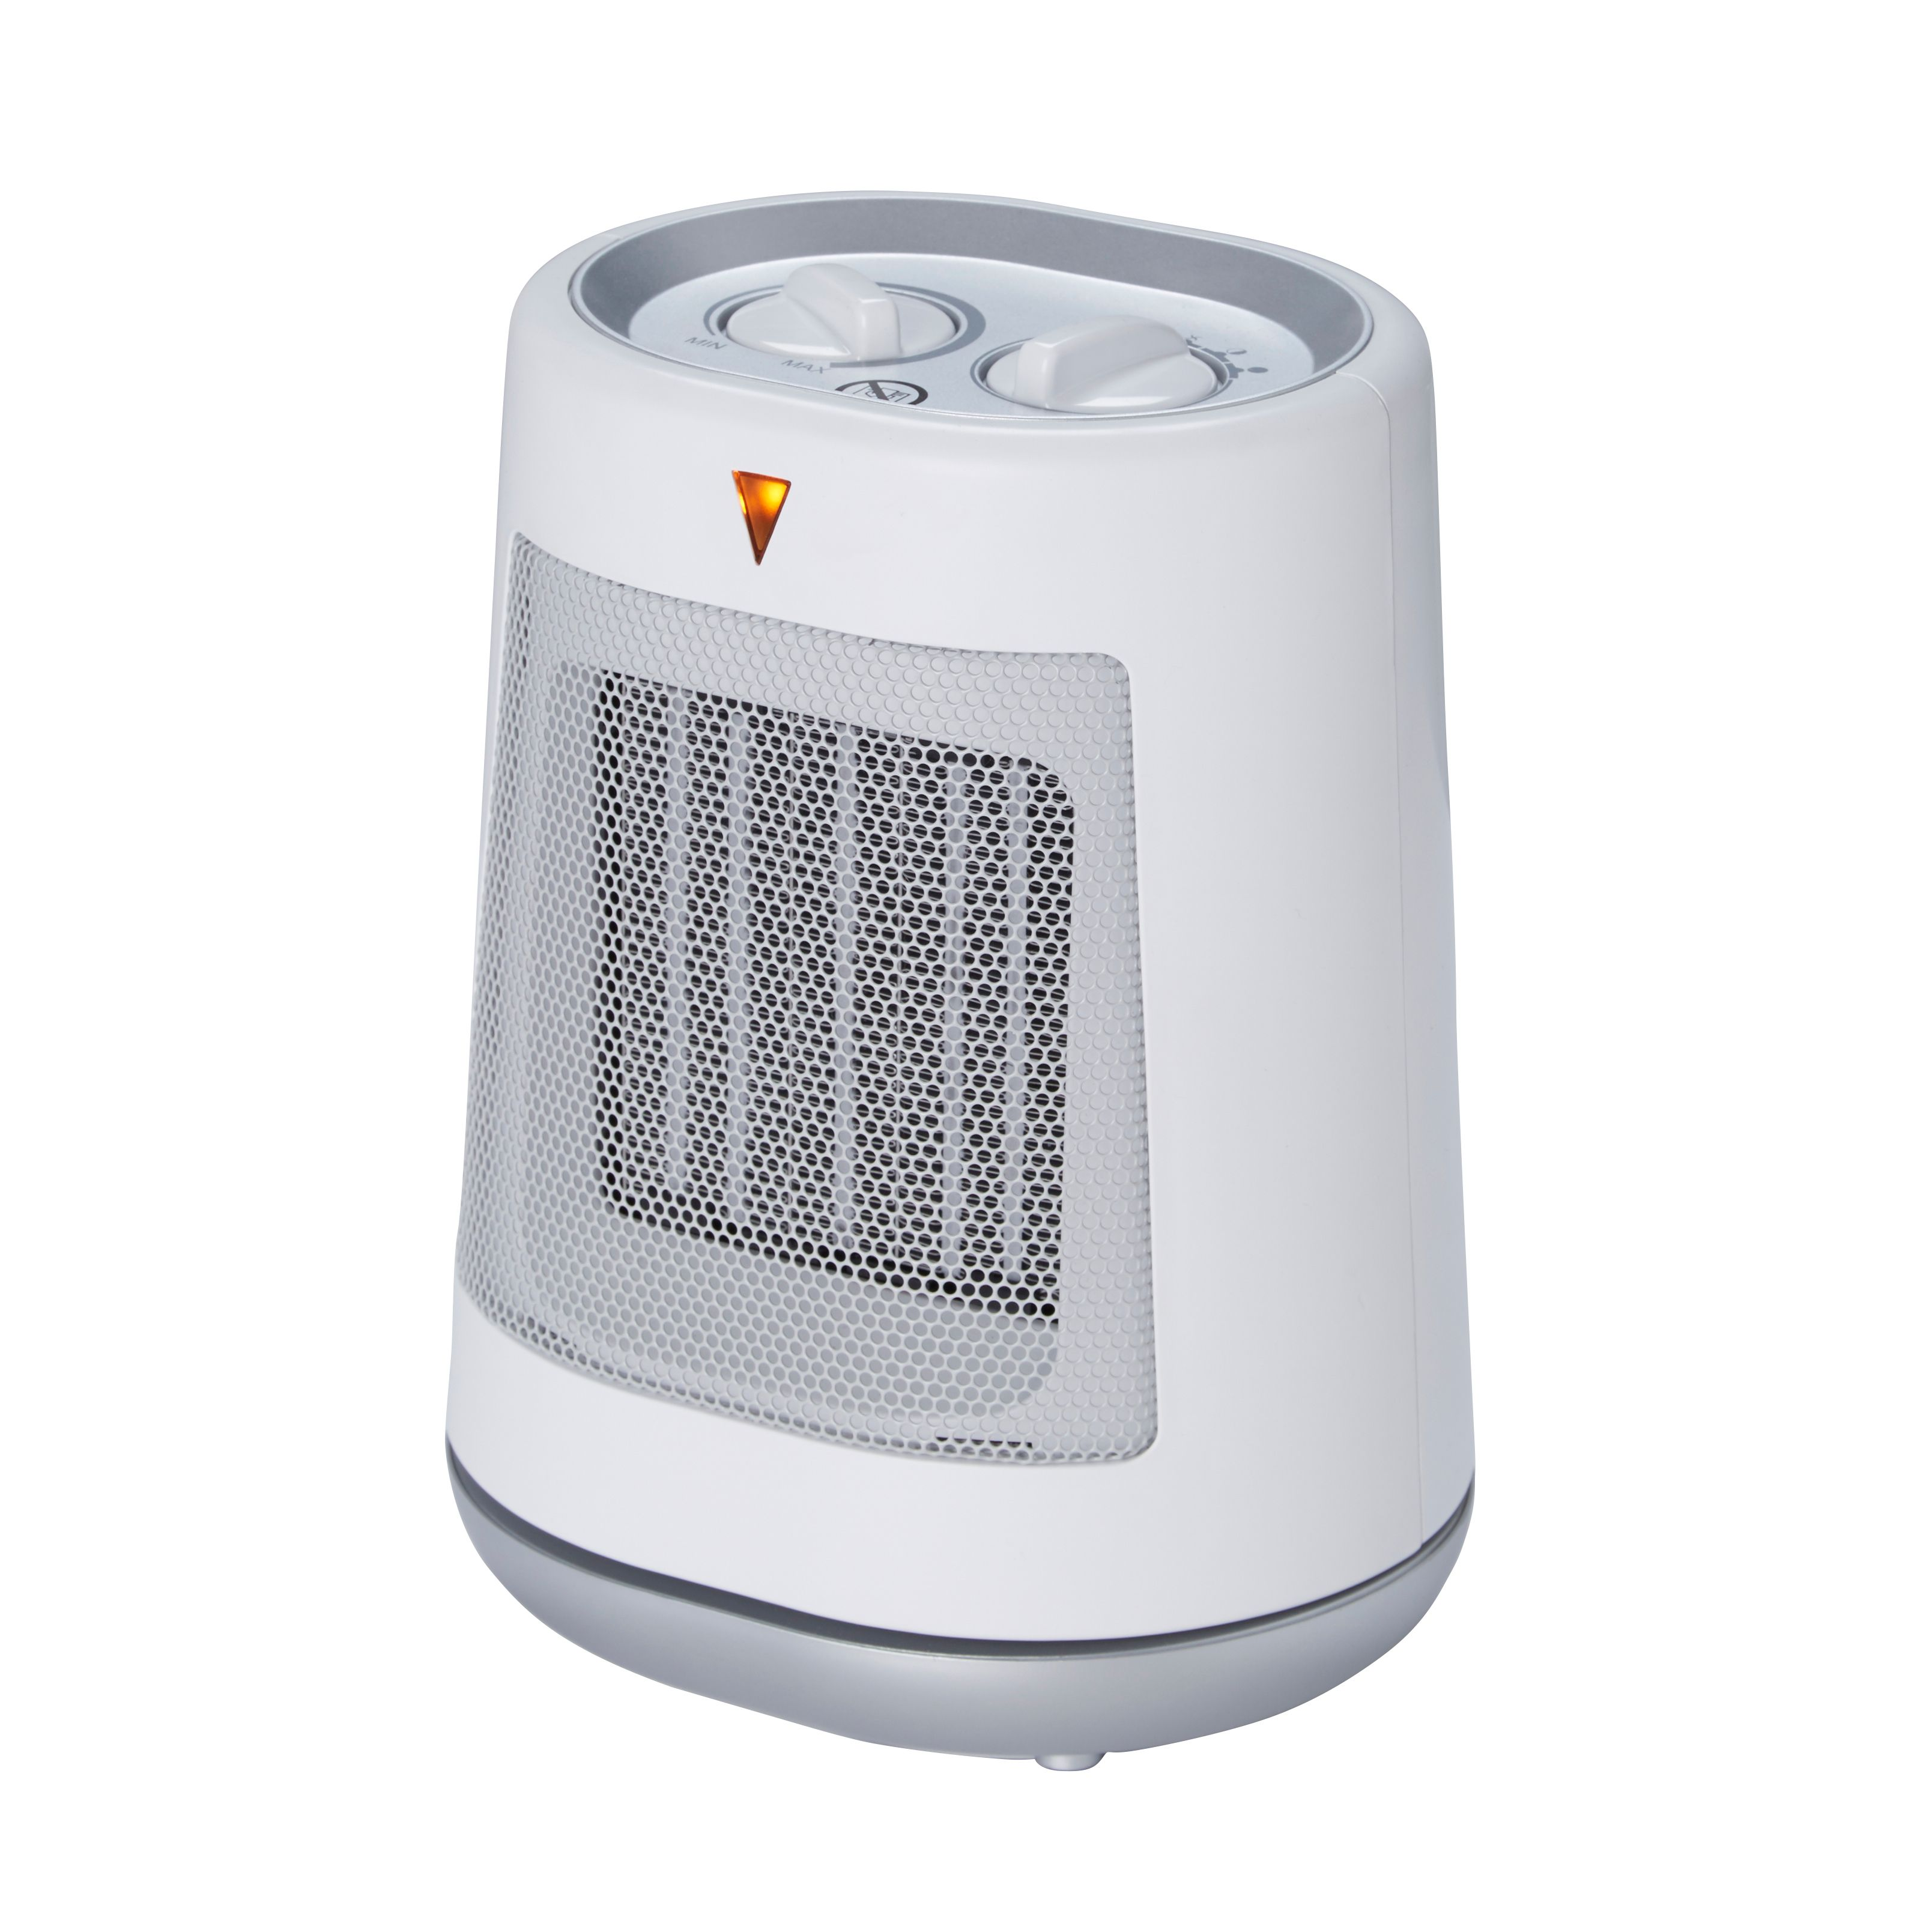
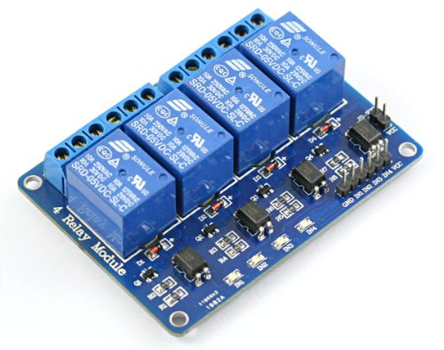
Work Flow Diagram (Scenario 1)
Acquiring & Posting Temperature Data to Cloud Services
Cloud Services
(Web+ DB Server)
PIR Motion Sensor
Temperature Sensor
DS18b20
1
3
2
Room is monitored for temperature, till the time it is occupied.
Algos running on cloud determine the weather conditions, and operate AC / Heater / Other appliances
PIR Motion Sensor , detects movement in room and interrupts Rpi.
Rpi checks current room temperature via Temp Sensor (DS18b20 – 1W Interface)
Temperature data is posted and processed at cloud (PHP / NodeJS)
Data is pushed to ESP8266 over cloud , which then controls the local appliances (AC / Heater) to maintain preset room temperature.
Switch On / Off the Appliance via Relay Module ie. Controlled by ESP8266 WiFi sub-system
4
Cooling Appliance
ESP8266 Wifi IoT
ESP8266 GPIO Pins
Heating Appliance

Slide 7




Work Flow Diagram (Scenario 2)
Notifying User
PIR Motion Sensor
Temperature Sensor
DS18b20
1
2
Room is monitored for temperature, till the time it is occupied.
PIR Motion Sensor , detects movement in room and interrupts Rpi.
Rpi checks current room temperature via Temp Sensor (DS18b20 – 1W Interface)
Temperature data is posted and processed at cloud (PHP / NodeJS)
Mobile Devices are updated via “RSS Feed” , “GCM (Google Cloud Messaging)”
Laptop & Desktops are updated via “RSS Feed”
Cloud Services
(Web+ DB Server)
3
5
4
RSS Feed
RSS Feed
GCM

Slide 8
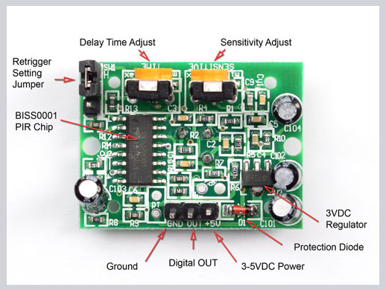
PIR Motion Sensor Explained

Slide 9
Cloud / Backend

Slide 10
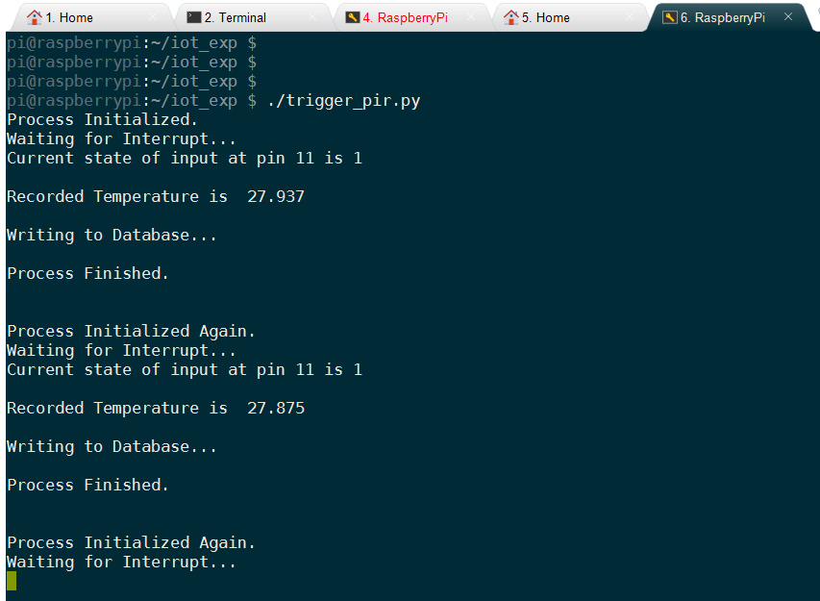
Console Output

Slide 11
Code - Python

Slide 12
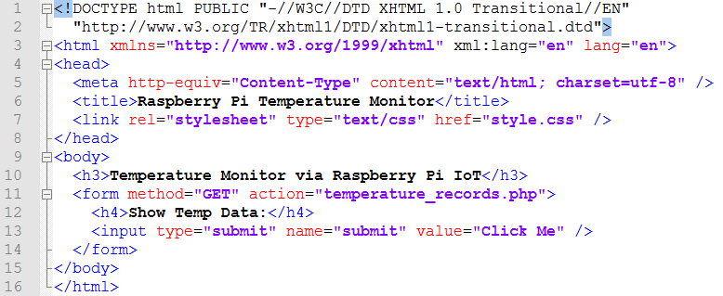
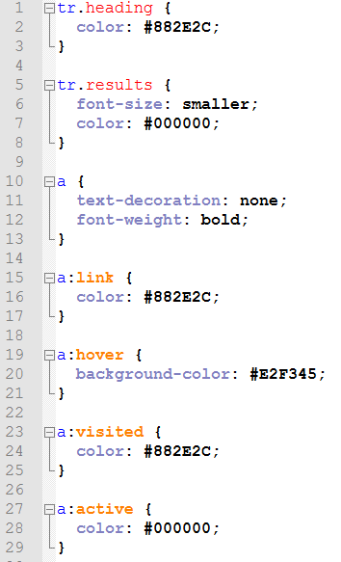
index.html
HTML / CSS
Welcome Page
style.css

Slide 13
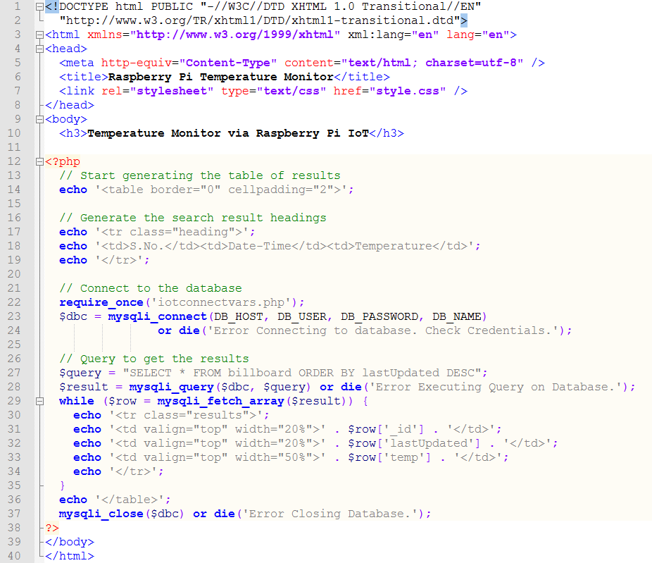
temperature_records.php
Push Temperature Data
To Cloud Server

Slide 14
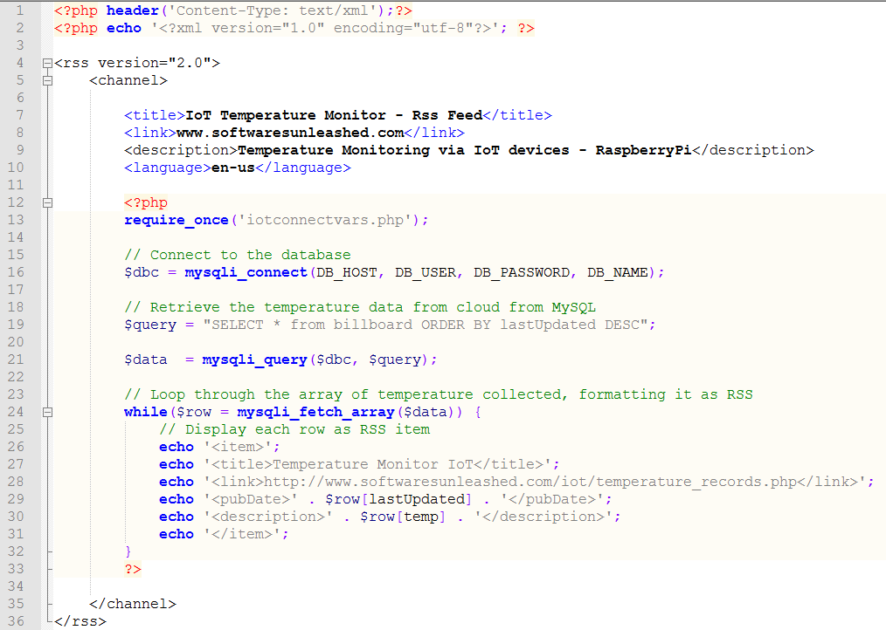
temperature_monitor_rssfeed.php
RSS Feed

Slide 15
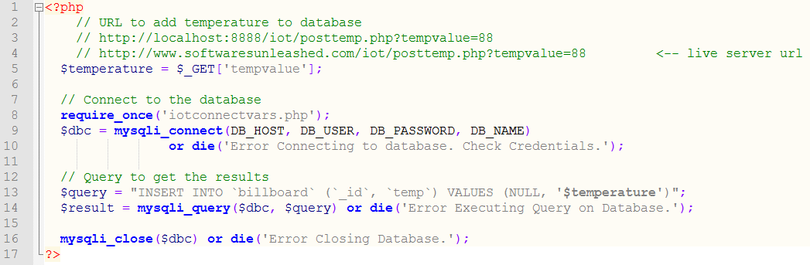
Temperature Posting Script To The Cloud
iotconnectvars.php

Slide 16
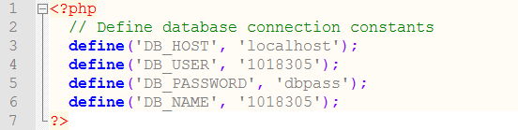
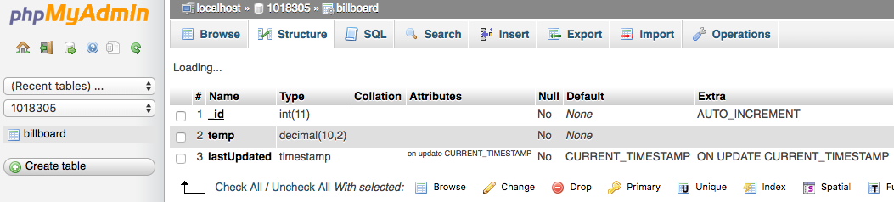
DB Connection Helper
Temp DB Table Structure

Slide 17
Sending Notification to Registered Devices
(Android , iOS, Web Client)

Slide 18
Wrong wiring / connections done between GPIO port & DS1820 temperature sensor
GPIO #4 had to be registered with W1 drivers via /boot/config.txt file.
(Name of the GPIO pin had to be used, and not the physical GPIO pin number.)
The timing / sensitivity rotatory rheostats had to be configured to generate little time duration interrupts.
Major Hurdles Conquered

Slide 19
Python (GPIO Pin Configuration)
PHP / MySQL (Cloud / Backend)
HTML / CSS (Welcome / Temperature Display Page)
Technologies Exploited

Slide 20
PHP Storm (Backend Code)
Android Studio (Android App)
vi / vim (Python Scripts on RaspberryPi)
Softwares

Slide 21
Internet connection 24x7 is needed for proper functioning of the proposed system.
Accuracy of Temperature sensor to predict temperature can affect working of system. This risk can be mitigated by adding multiple Temperature sensors in series and averaging their value.
Accuracy of PIR Motion Sensor can affect proper working of the system.
Risks

Slide 22
Room is automatically monitored till its occupied using PIR motion sensor.
Algos running on cloud servers , find out the current weather (summers/ winters) , based on the temperature data collected.
These algos, bring temperature to normal room temperature (25 deg C), by switching on / off relevant appliances (Heater / AC / Fan).
Innovation

